Slide 1

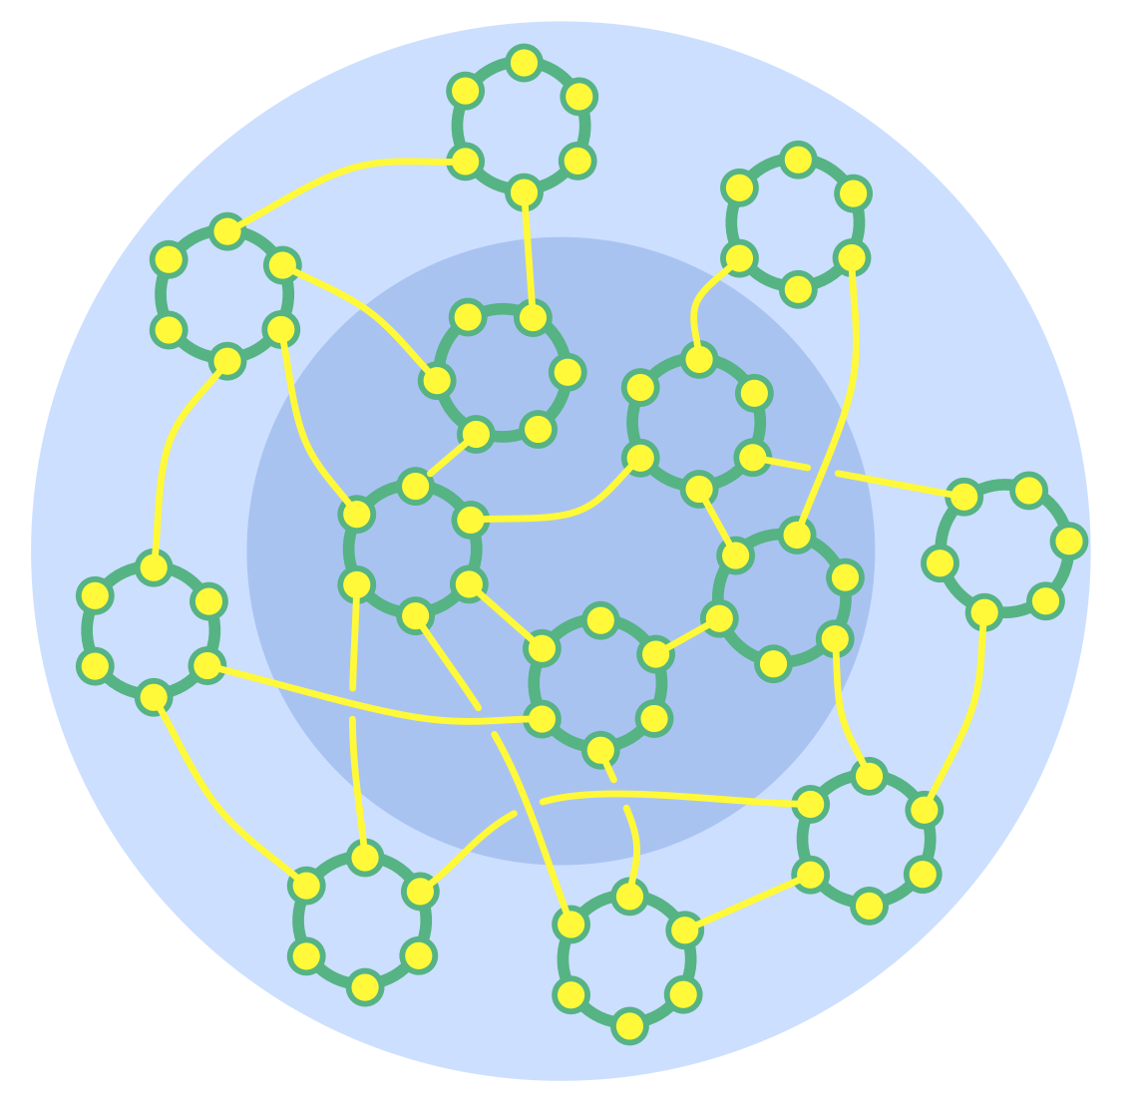
IMPROVING EFFICIENCY WITH OPEN ORGANIZATIONAL PRACTICES Barbaros Günay
Notes:
Open Systems
Intentionally communicate with and learn from others outside of your system.
Individuals, groups and entire organizations can acknowledge interdependence and intentionally invite people from outside their system to bring in knowledge, experience and influence to assist with decision making and support collective learning.
Acknowledging its interdependence, an organization can consciously invite outside information, influence or skills to assist with making decisions and to support collective learning.
External experts can offer an outside perspective and bring knowledge, understanding and skills
Representatives of affected parties can inform and influence decision making in ways that benefit overall objectives (see Those Affected Decide)

Slide 2


Love song to efficiency, alignment, fulfillment, openness and wellbeing
“…happy people have not much to say, sad people have much more to say to explain…”, Aznavour on love songs– Parkinson Interview ,1974
Notes:
Based on personal experience, observation and others’ stories (as Aznouver said 30-40% personal, the rest is listening others)

Slide 3
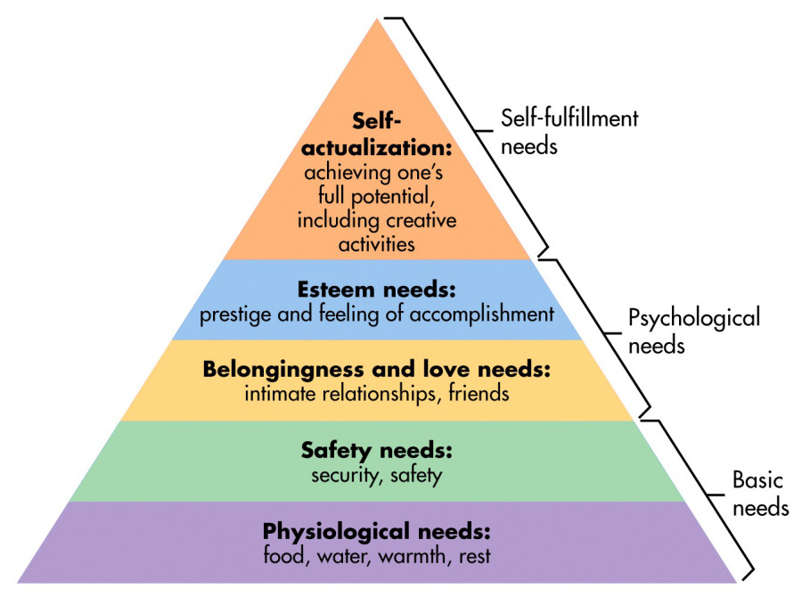
Human Activity and desires
Bertrand Russell – Nobel Lecture, December 11, 1950
Four desires can never be fully gratified,
acquisitiveness
rivalry
vanity
love of power
Fear and hate
Boredom and Love of excitement
Selfishness and intelligence
Recognition, approval, high status, increased responsibilities
Work Groups, client, coworkers
Heat , base salary
Safe work , benefits, job security
Opportunities for advancement, autonomy, growth, creativity
Maslow’s Hierarchy of needs
Work environment mapping
Notes:
1- Heat , base salary
2-Safe work , benefits, job security
3- Work Groups, clients, coworkers, supervisors
4- Recognition, approval, high status, increased responsibilities
5- Opportunities for advancement, autonomy, growth, creativity
Produce not just a product , strategy, long term decisions, etc…
Gizli bilgi oyunu, bana gizli bilgileri kim koruyacak manager olmazsa diye soranlar
Bilginin güç olması, saklmanın maliyeti,
acquisitiveness (açgözlülük)
rivalry (rekabet eğilimi, hırs)
vanity (gösteriş, kibir)
love of power (Güç aşkı, iktidar sevgisi)
Why related
Hiding information regarded as power
Acquisitiveness - the wish to possess as much as possible of goods, or the title to goods - is a motive which, I suppose, has its origin in a combination of fear with the desire for necessaries. I once befriended two little girls from Estonia, who had narrowly escaped death from starvation in a famine. They lived in my family, and of course had plenty to eat. But they spent all their leisure visiting neighbouring farms and stealing potatoes, which they hoarded. Rockefeller, who in his infancy had experienced great poverty, spent his adult life in a similar manner. Similarly the Arab chieftains on their silken Byzantine divans could not forget the desert, and hoarded riches far beyond any possible physical need. But whatever may be the psychoanalysis of acquisitiveness, no one can deny that it is one of the great motives - especially among the more powerful, for, as I said before, it is one of the infinite motives. However much you may acquire, you will always wish to acquire more; satiety is a dream which will always elude you. But acquisitiveness, although it is the mainspring of the capitalist system, is by no means the most powerful of the motives that survive the conquest of hunger. Rivalry is a much stronger motive. Over and over again in Mohammedan history, dynasties have come to grief because the sons of a sultan by different mothers could not agree, and in the resulting civil war universal ruin resulted. The same sort of thing happens in modern Europe. When the British Government very unwisely allowed the Kaiser to be present at a naval review at Spithead, the thought which arose in his mind was not the one which we had intended. What he thought was, «I must have a Navy as good as Grandmamma's». And from this thought have sprung all our subsequent troubles. The world would be a happier place than it is if acquisitiveness were always stronger than rivalry. But in fact, a great many men will cheerfully face impoverishment if they can thereby secure complete ruin for their rivals. Hence the present level of taxation. Vanity is a motive of immense potency. Anyone who has much to do with children knows how they are constantly performing some antic, and saying «Look at me». «Look at me» is one of the most fundamental desires of the human heart. It can take innumerable forms, from buffoonery to the pursuit of posthumous fame. There was a Renaissance Italian princeling who was asked by the priest on his deathbed if he had anything to repent of. «Yes», he said, «there is one thing. On one occasion I had a visit from the Emperor and the Pope simultaneously. I took them to the top of my tower to see the view, and I neglected the opportunity to throw them both down, which would have given me immortal fame». History does not relate whether the priest gave him absolution. One of the troubles about vanity is that it grows with what it feeds on. The more you are talked about, the more you will wish to be talked about. The condemned murderer who is allowed to see the account of his trial in the press is indignant if he finds a newspaper which has reported it inadequately. And the more he finds about himself in other newspapers, the more indignant he will be with the one whose reports are meagre. Politicians and literary men are in the same case. And the more famous they become, the more difficult the press-cutting agency finds it to satisfy them. It is scarcely possible to exaggerate the influence of vanity throughout the range of human life, from the child of three to the potentate at whose frown the world trembles. Mankind have even committed the impiety of attributing similar desires to the Deity, whom they imagine avid for continual praise. But great as is the influence of the motives we have been considering, there is one which outweighs them all. I mean the love of power. Love of power is closely akin to vanity, but it is not by any means the same thing. What vanity needs for its satisfaction is glory, and it is easy to have glory without power. The people who enjoy the greatest glory in the United States are film stars, but they can be put in their place by the Committee for Un-American Activities, which enjoys no glory whatever. In England, the King has more glory than the Prime Minister, but the Prime Minister has more power than the King. Many people prefer glory to power, but on the whole these people have less effect upon the course of events than those who prefer power to glory. When Blücher, in 1814, saw Napoleon's palaces, he said, «Wasn't he a fool to have all this and to go running after Moscow.» Napoleon, who certainly was not destitute of vanity, preferred power when he had to choose. To Blücher, this choice seemed foolish. Power, like vanity, is insatiable. Nothing short of omnipotence could satisfy it completely. And as it is especially the vice of energetic men, the causal efficacy of love of power is out of all proportion to its frequency. It is, indeed, by far the strongest motive in the lives of important men. Love of power is greatly increased by the experience of power, and this applies to petty power as well as to that of potentates. In the happy days before 1914, when well-to-do ladies could acquire a host of servants, their pleasure in exercising power over the domestics steadily increased with age. Similarly, in any autocratic regime, the holders of power become increasingly tyrannical with experience of the delights that power can afford. Since power over human beings is shown in making them do what they would rather not do, the man who is actuated by love of power is more apt to inflict pain than to permit pleasure. If you ask your boss for leave of absence from the office on some legitimate occasion, his love of power will derive more satisfaction from a refusal than from a consent. If you require a building permit, the petty official concerned will obviously get more pleasure from saying «No» than from saying «Yes». It is this sort of thing which makes the love of power such a dangerous motive.

Slide 4
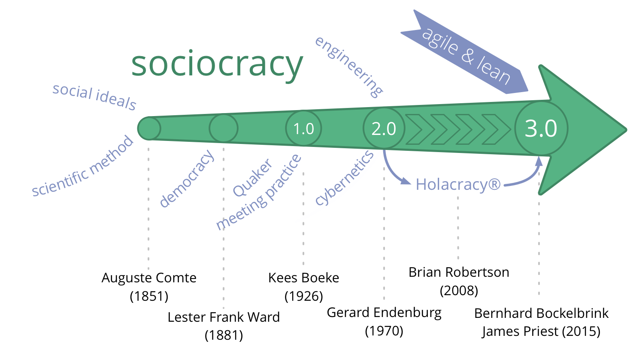
Notes:
Hundreds years ago same idea shaped under different conditions
WHY A SOCIOCRACY?
Following almost a century of political revolutions in which monarchies and aristocracies were overturned or stripped of power, Comte was searching for a rational basis for government. Governance on the basis of inherited rights, personal wealth, religious dictates, and military power had all proven corruptible and not in the interests of the people.
Comte had developed a philosophy called “positivism” in which knowledge is based on what is known of the natural world, of what could be proven and not what a monarch or the church decreed. He believed that a society governed by scientists could use scientific method to decide the best social and economic policies.
LIMITATIONS OF AN IDEAL
Sociology remained an ideal, however, because Comte was a philosopher, a theorist. Implementation would need the rhetorical skills of a political critic and an educator.
What’s in a word?
• socio- from Latin socius - companion, friend
• -cracy from Ancient Greek krátos - “power, rule”
• different to the rule of the demos (i.e. the general mass of people with voting privileges)
Figure 2.1: A Brief History of Sociocracy from 1851 to Today
• 1851 – Auguste Comte
– Scientific method applied to society
Sociocracy is “the social order of the future” - not yet achievable but inevitable!
• 1881 – Lester Frank Ward
– redefined the term Sociocracy to describe the rule of the people with relationships
with each other
• 1926 –1954 - Kees Boeke
– Established the first sociocracy in his residential school (based on Quaker consensus
principles)
– Book “Sociocracy: Democracy as it might be” (1945)
• 1970’s - Gerard Endenburg
– Student in Kees Boeke’s school
– Integrated principles from Engineering and Cybernetics
In his company Endenburg Electrotechniek he evolved “The Sociocratic Circle-
Organization Method” (later becoming “The Sociocratic Method”)
• 1978 - Sociocratisch Centrum Utrecht
– created to promote “The Sociocratic Method”
• 1994 - New law in the Netherlands
– Sociocratic organizations are no longer required to have a worker’s council
• 2000 - emergence of a now wide-spread grassroots movement
• 2007 - We the People
– John Buck /Sharon Villines make Sociocracy accessible to the English-speaking
world
• 2014 The Sociocracy 3.0 Movement is born
---- Following almost a century of political revolutions in which monarchies and aristocracies were overturned or stripped of power, Comte was searching for a rational basis for government. Governance on the basis of inherited rights, personal wealth, religious dictates, and military power had all proven corruptible and not in the interests of the people.
Comte had developed a philosophy called “positivism” in which knowledge is based on what is known of the natural world, of what could be proven and not what a monarch or the church decreed. He believed that a society governed by scientists could use scientific method to decide the best social and economic policies.
__

Slide 5

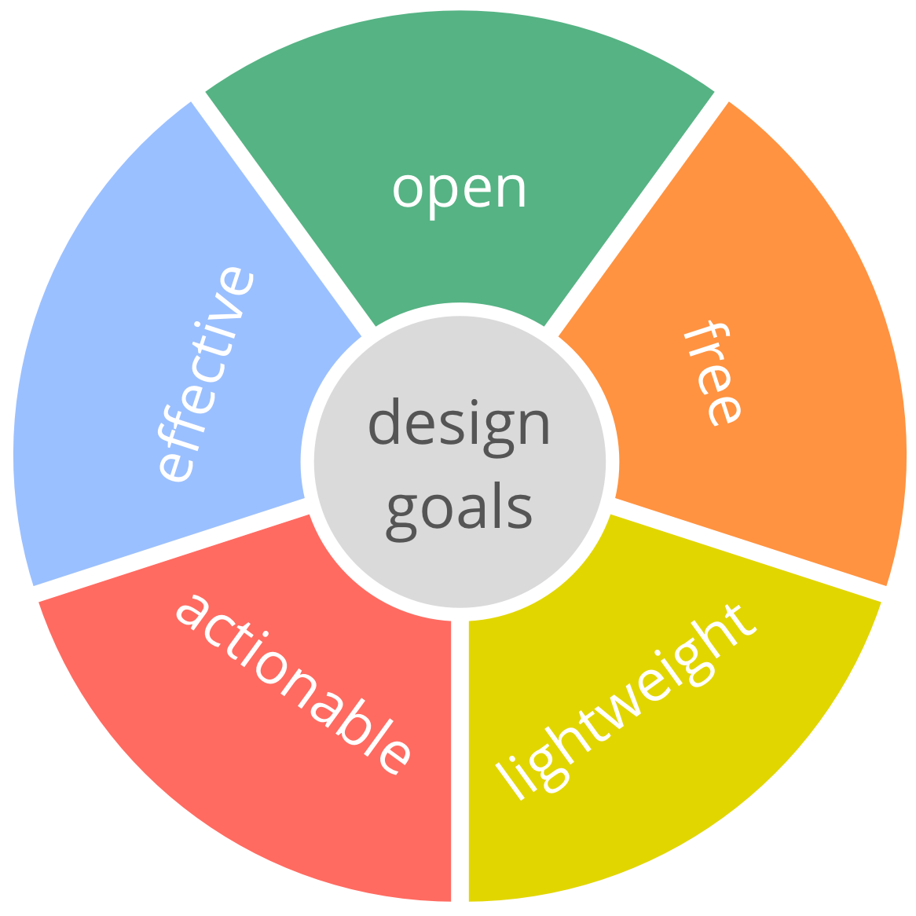
DESIGN GOALS
Notes:
Design Goals
Open: Principle-based and modular patterns make it easy to choose and adapt according to context
• do with it what you want
• take just what you need
• remix, extend and adapt it as you like
Free: Un-centralized distribution and a Commons license eliminates barriers to entry:
• free and accessible resources
• no hidden fees
• no certifications
• no small print
Effective: Principles and patterns have been tried and tested in many organizations, often for decades.
• need-driven
• value-driven customer/user focus
Actionable: There’s something any organization can use right now, regardless of their unique context. S3 contains lots of ideas anyone can try out within their area of influence.
• patterns for individuals
• patterns for groups
• patterns for organizations
Lightweight: Just the essentials:
common-sense practices, bare-bone processes:
• free of stuff that gets in the way
• no busywork or unnecessary bureaucracy

Slide 6
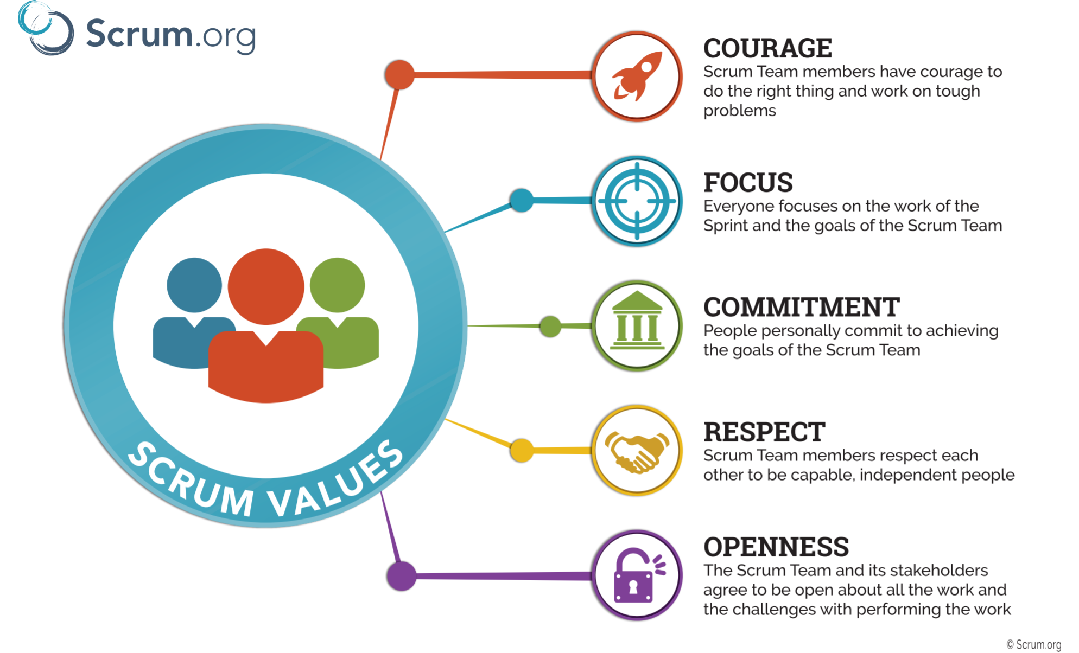
Notes:
Similarities to Scrum

Slide 7
An Open Framework helps any kind of community to become more
Effective
Agile
Resilient
S3 patterns creates positive open environments for individuals, teams and whole organizations, by enabling people to..:
dynamically steer and evolve their organizations.
learn, transform and grow
make the best use of the skills already present
grow flexible organizational structures in support of effective flow of information.
take an open, iterative approach to adoption
draw on the collective intelligence of the group.
SOCIOCRACY 3.0 (S3)
Notes:
Sociocracy 3.0 (also known as S3) is a framework of patterns for collaboration in organizations that wish to grow more effective, agile and resilient. It be applied in organizations of any size, from small start-ups to large international networks and nationwide, multi-agency collaboration.
It be applied in organizations of any size, from small start-ups to large international
networks and nationwide, multi-agency collaboration.
S3 contains patterns ready to use for many different aspects of collaboration, including
patterns that enable organizations to discover and develop new patterns according to their
needs.
The patterns in S3 form a pattern language, i.e. while each pattern can be applied
independently, patterns mutually reinforce each other, because they are all based on the
same set of principles (see the Seven Principles at the end of the introduction).
S3 patterns facilitate positive transformation for individuals, teams and whole organizations
by enabling people to..:
• ... dynamically steer and evolve their organizations.
• . . . commit to agreements and account for the consequences
• . . . learn, transform and grow
• . . . incrementally process available information into continuous improvement of
products, processes and skills*.
• . . . make the best use of the skills already present
• . . . grow flexible organizational structures in support of effective flow of information.
• . . . take an open, iterative approach to adoption that meets organizations where
they are and enables them to move forward at their own pace.
• . . . draw on the collective intelligence of the group.
• . . . develop creative strategies that are “good enough for now” and “safe enough
to try”.
The focus of this handbook is mostly on S3 in the context of organizations. The patterns
themselves are valuable to any group of people who wish to collaborate effectively, including
communities, municipalities, families, and even one-to-one relationships.

Slide 8
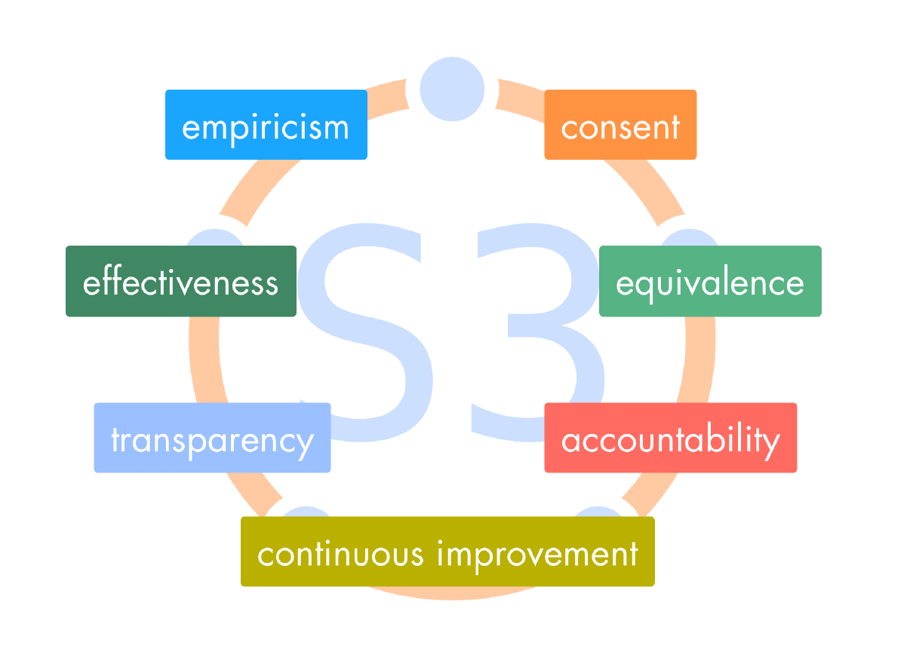
Seven Principles of Sociocracy Patterns
Notes:
5.2 The Seven Principles S3 is built on seven core principles, which can also be considered as values that shape organizational culture. Understanding these principles is helpful for adopting and paramount to adapting S3 patterns. Practicing S3 helps people appreciate the essential value of the Seven Principles, both to individuals and organizations
The Principle of Effectiveness: Devote time only to what brings you closer towards achieving your objectives. Avoid waste, remove impedimentts and look for solutions which are good enough for now, safe enough to try.
The Principle of Consent: Do things only in the absence of reasons why doing so would stand in the way of (more) effectively meeting shared objectives. When dealing with complexity, group wisdom exceeds individual abilities. Deliberately seeking out objections invites collective intelligence to improve an agreement and helps identify misunderstanding early. This fosters support and accountability for agreements made.
The Principle of Empiricism: Test all assumptions about an organization and its interactions through experiments, continuous revision and falsification. In any complex adaptive system, such as a group or an organization, all knowledge about the system and its interactions is tentative, and highly dependent on context. Making use of experiences gained from probing and observing the system creates a learning organization which is effective and resilient to change. Empiricism is the basis of the scientific method and the combined application of S3’s patterns provides a direct way to apply the scientific method in an organization.
The Principle of Continuous Improvement: Respond to change in small increments, by building on and transforming what is already there, to reduce risk and resistance, and to accommodate steady empirical learning. Most of the time evolution is more effective and more sustainable than revolution. Continuous improvement applies to everything, e.g. strategies, guidelines, products, skills, processes, values and tools.
The Principle of Equivalence: People affected by decisions can influence and change them on the basis of reason to do so. Position, rank, function and role have no special influence in decision making.
The Principle of Transparency: Make all information accessible to anyone in an organization. Confidentiality requires consent. All relevant information is kept up-to-date, and historical information is archived for reference.
The Principle of Accountability: Respond when something is needed and be accountable for doing what you agreed to. The principle of accountability applies to groups, organizations and individuals, and promotes a shift from being held to account, and towards a culture of self-accountability. It implies both making commitments and managing expectations in any relationship: entering agreements, doing what we agree to and to answer for when we don’t.

Slide 9
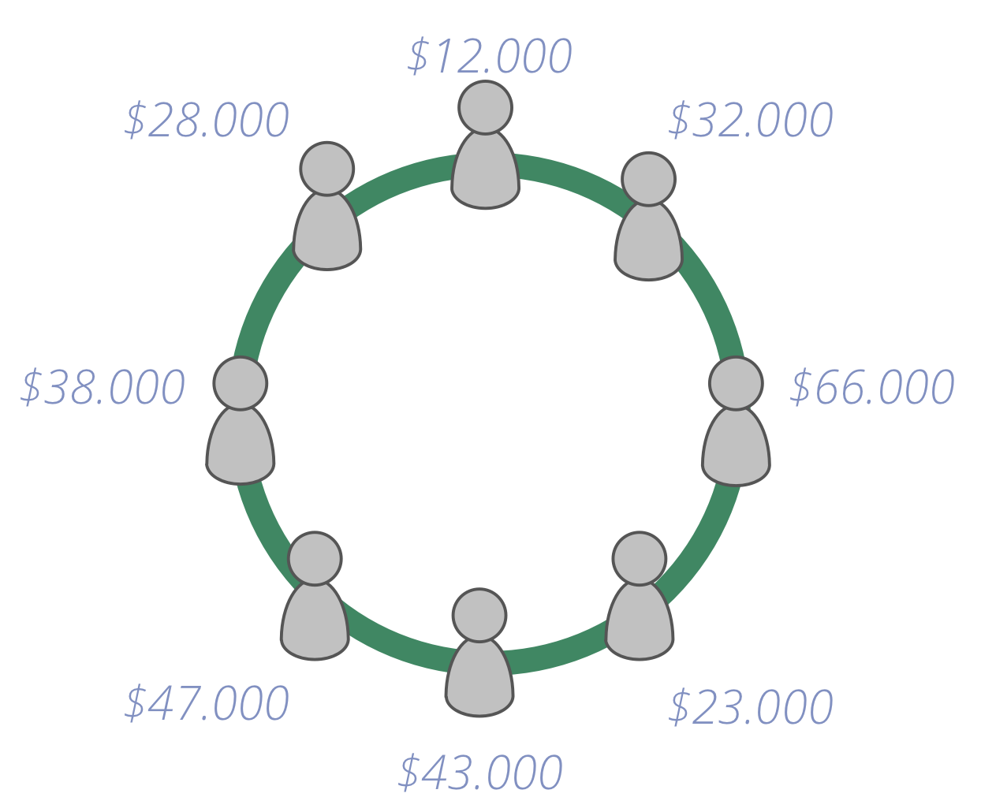
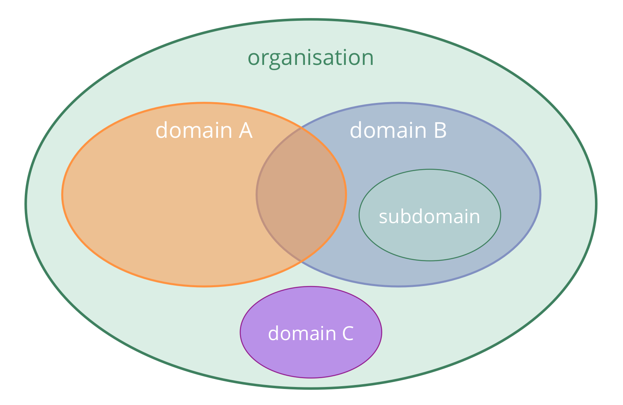
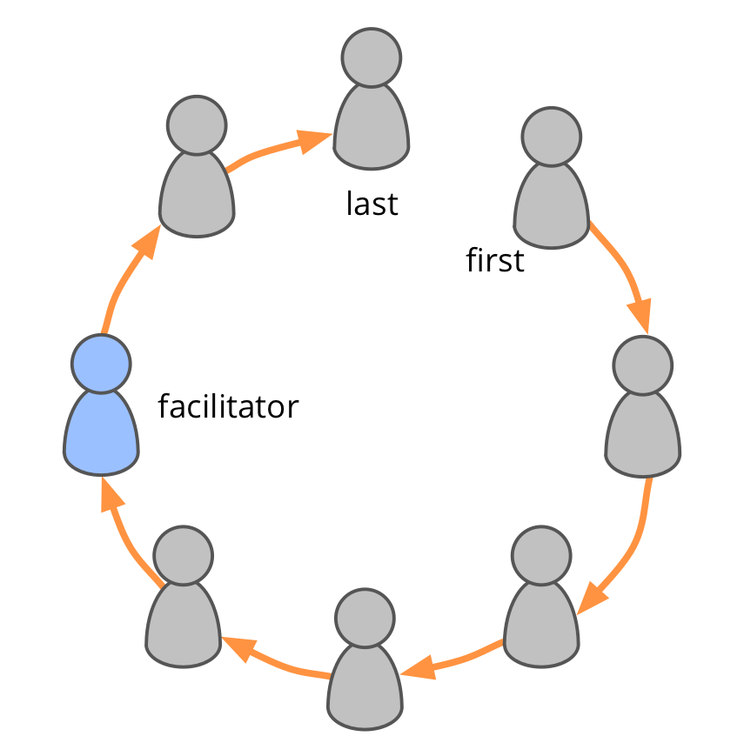
CIRCLE ORGANIZATION
Notes:
Open Systems
Intentionally communicate with and learn from others outside of your system.
Individuals, groups and entire organizations can acknowledge interdependence and intentionally invite people from outside their system to bring in knowledge, experience and influence to assist with decision making and support collective learning.
Acknowledging its interdependence, an organization can consciously invite outside information, influence or skills to assist with making decisions and to support collective learning.
External experts can offer an outside perspective and bring knowledge, understanding and skills
Representatives of affected parties can inform and influence decision making in ways that benefit overall objectives (see Those Affected Decide)
Circle
A circle is a semi-autonomous, self-organizing and self-governing group of people collaborating
to respond to a driver.
A circle is the basic unit of collaboration in an organization: a group of people gathered
around a driver (permanently or temporarily). A circle brings together different perspectives
and skills, has no hierarchy when it comes to decision making, and is accountable for its
own development.
semi-autonomous:
– each circle has a unique driver and can create value independently
• self-organizing:
– independent in organizing day-to-day-work
• self-governing:
– independent in creating strategy and agreements in response to the circle’s driver.

Slide 10
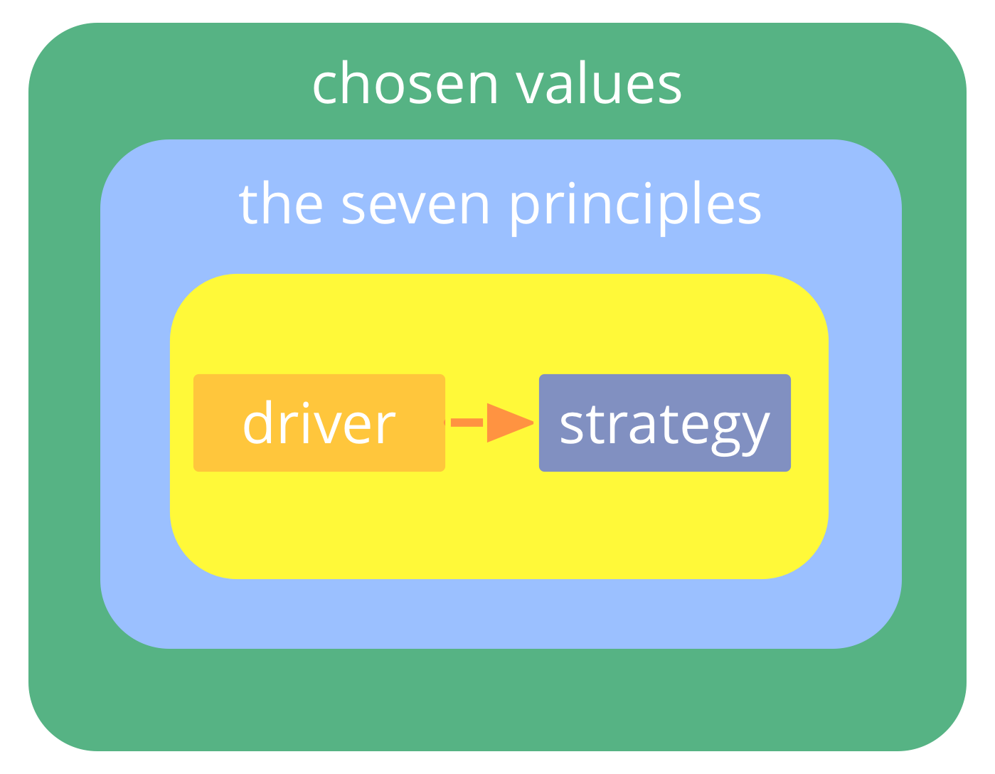
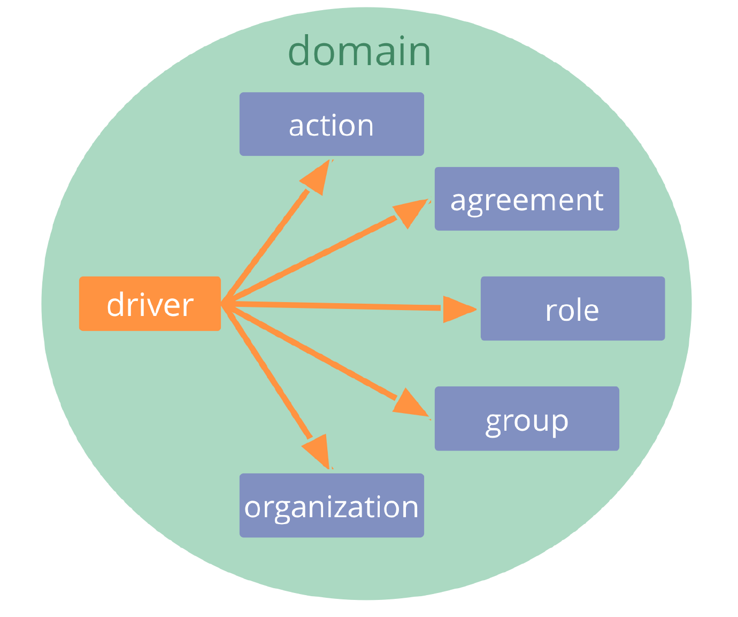
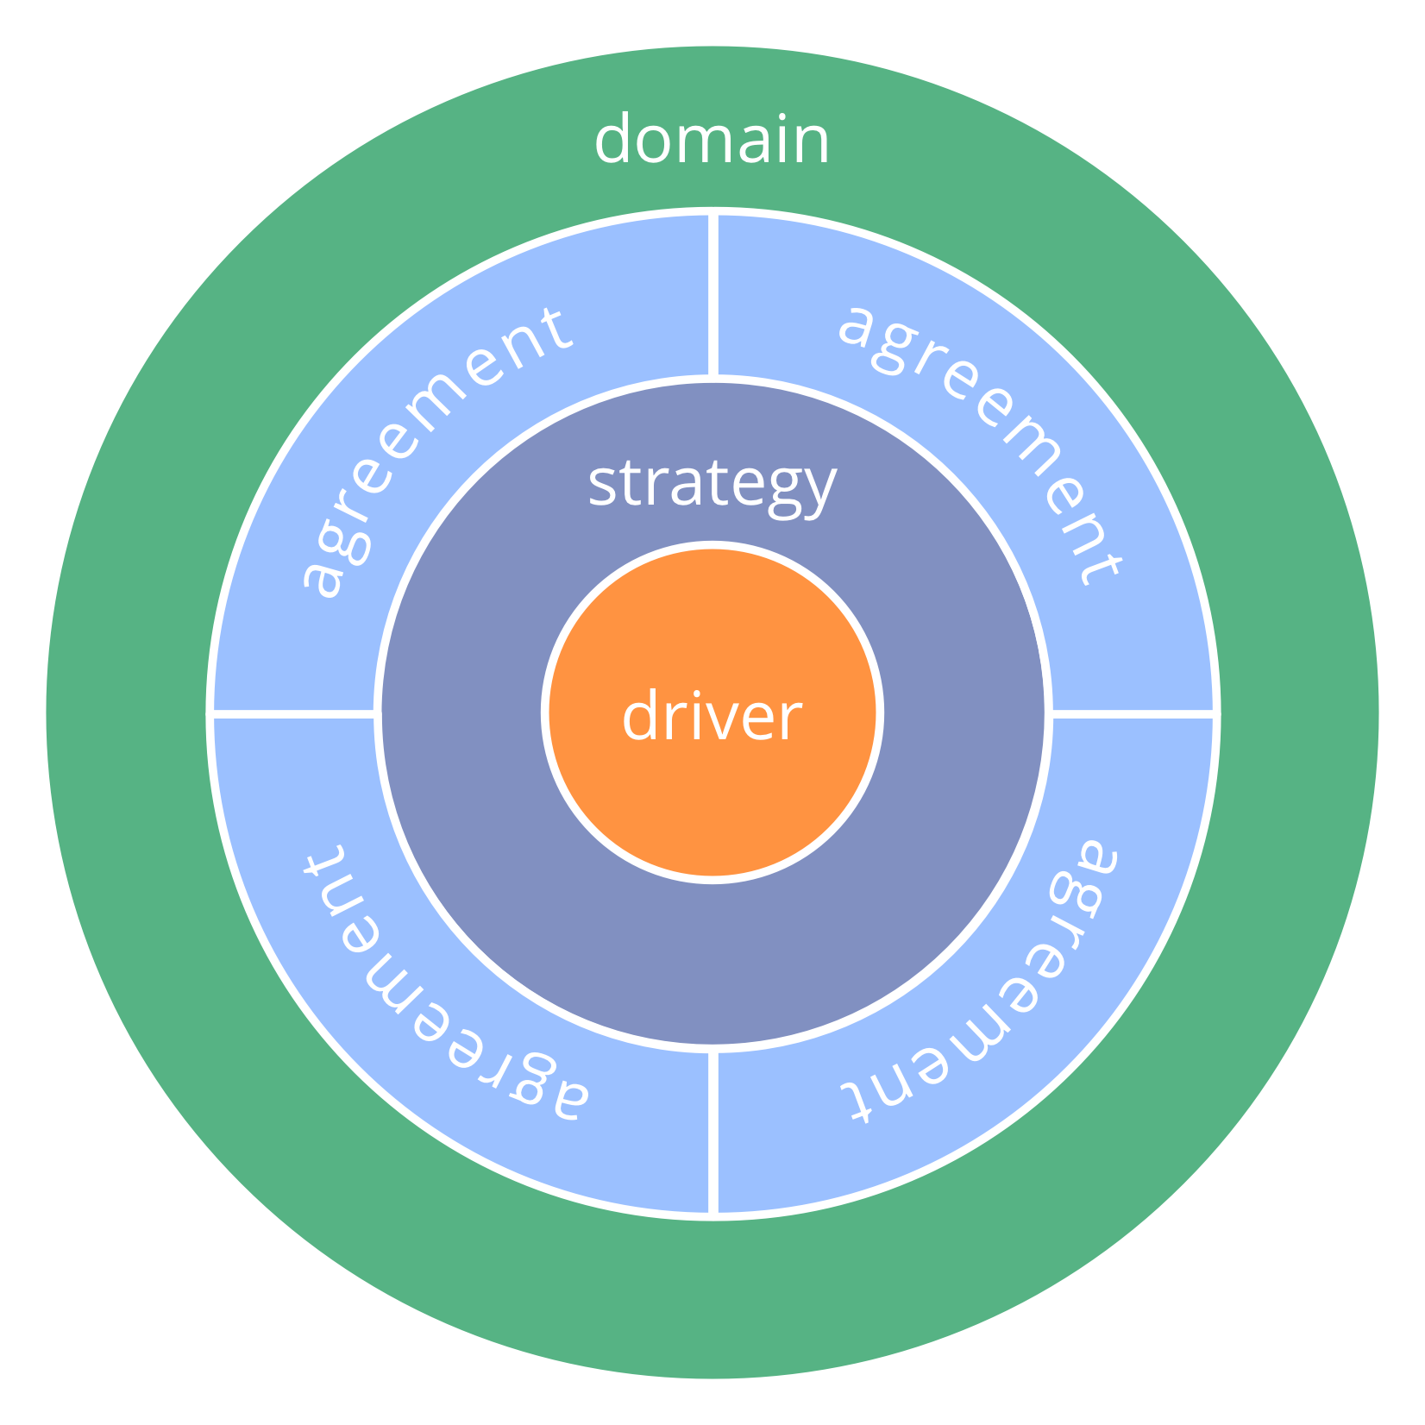
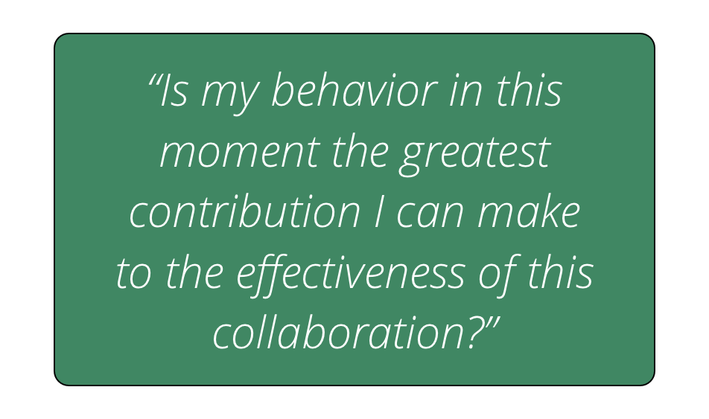
Drivers, Domains and Behaviours

Slide 11
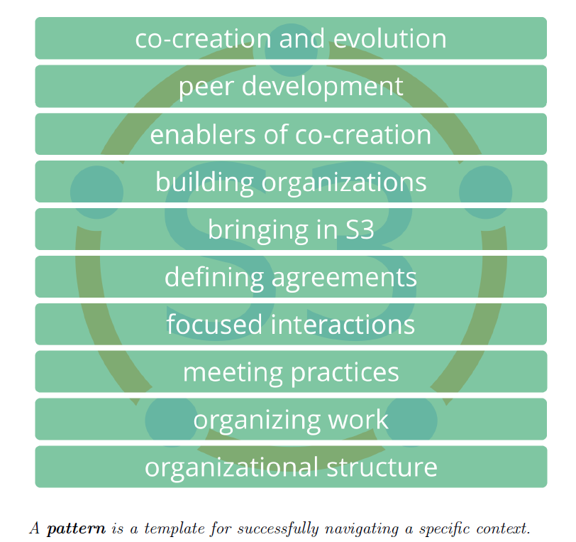
Patterns

Slide 12
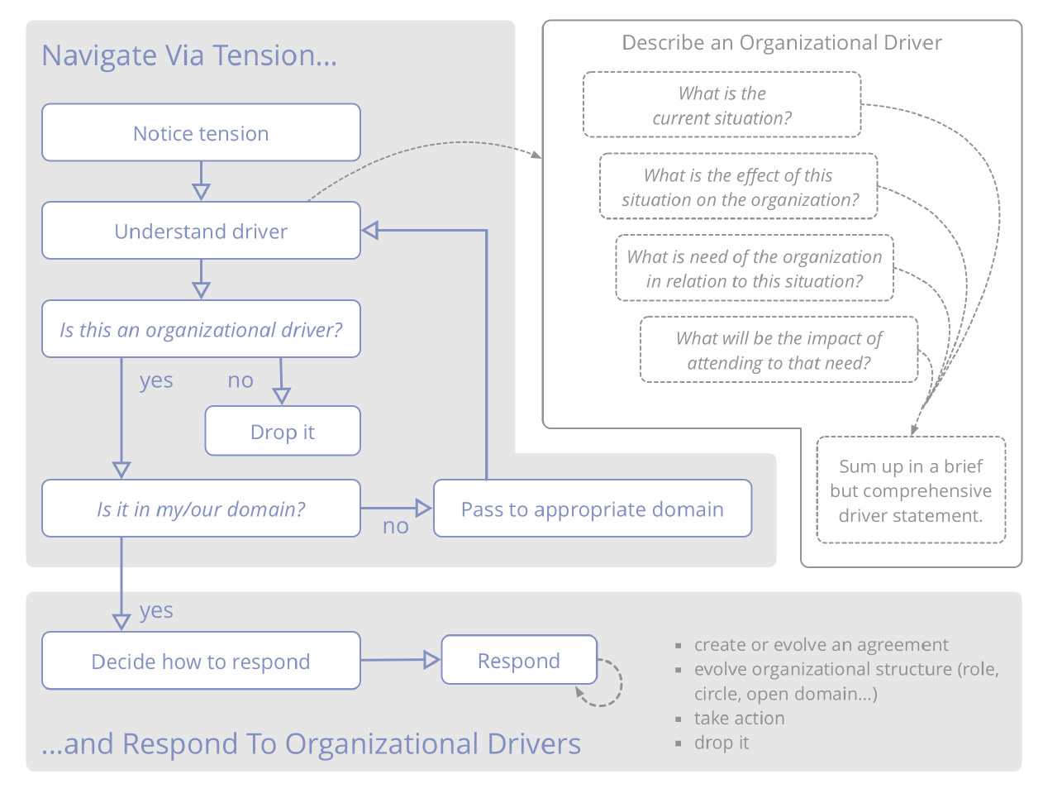
Navigate via tension

Slide 13
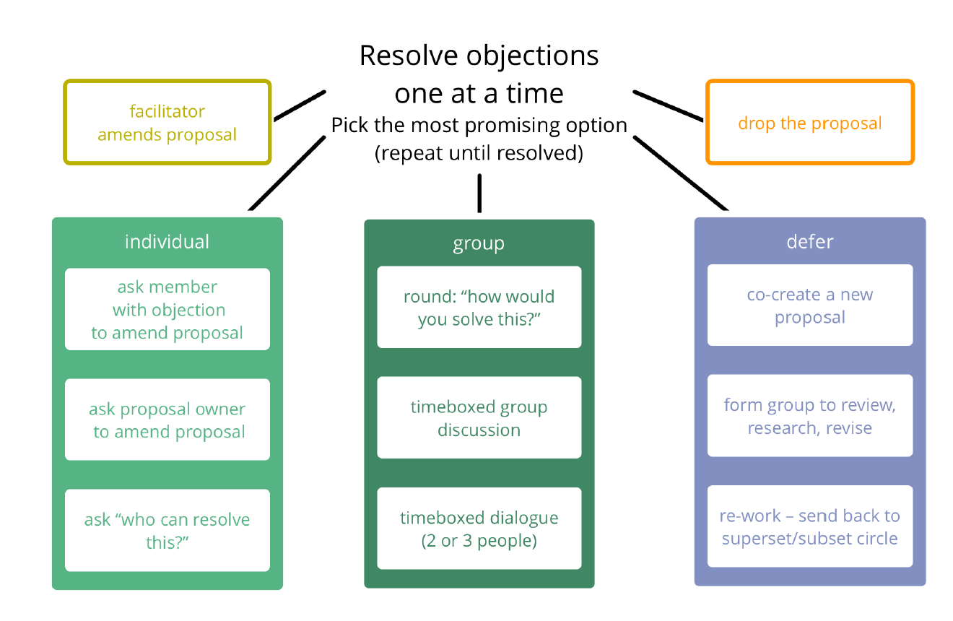
Resolve Objections

Slide 14
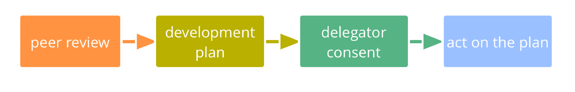
Peer Review

Slide 15
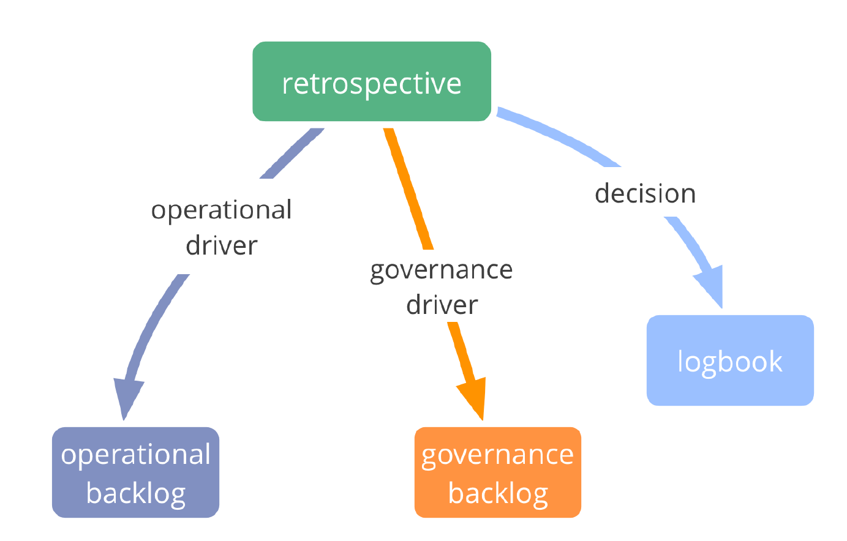
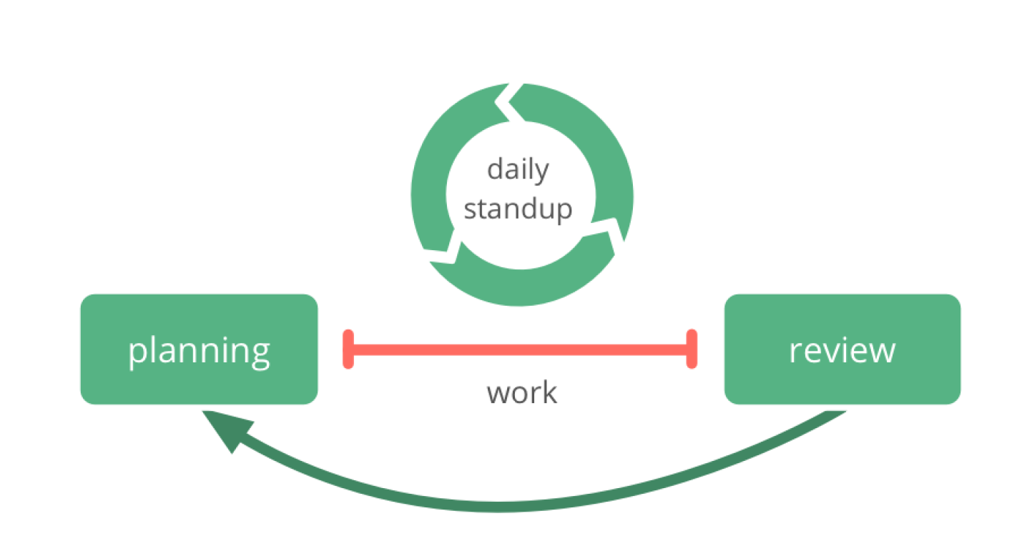
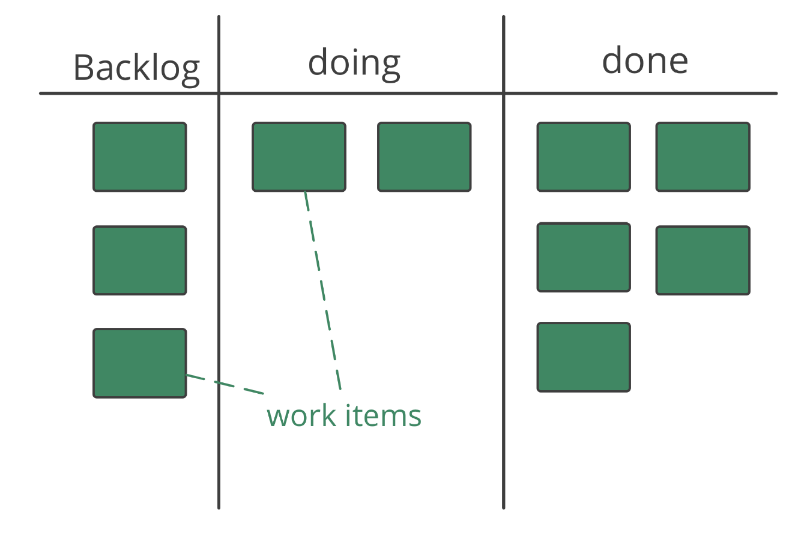
Backlogs & Planning

Slide 16
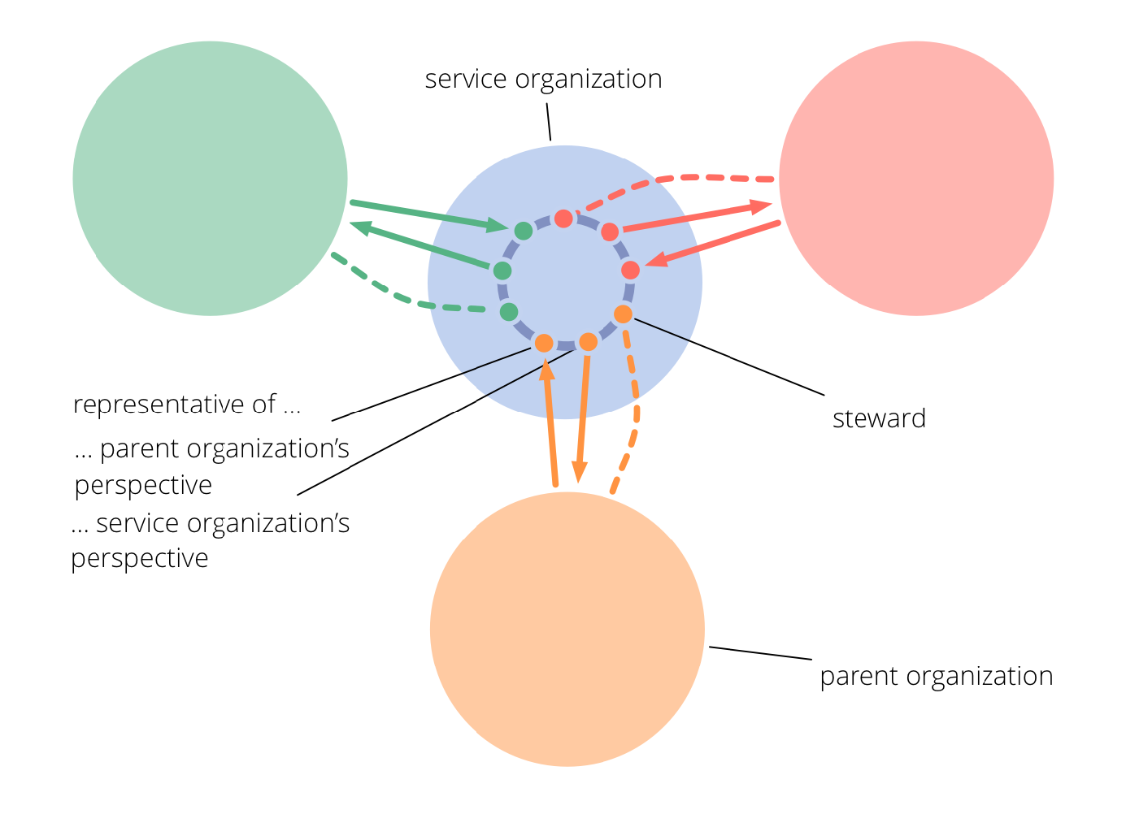
Service Organization

Slide 17
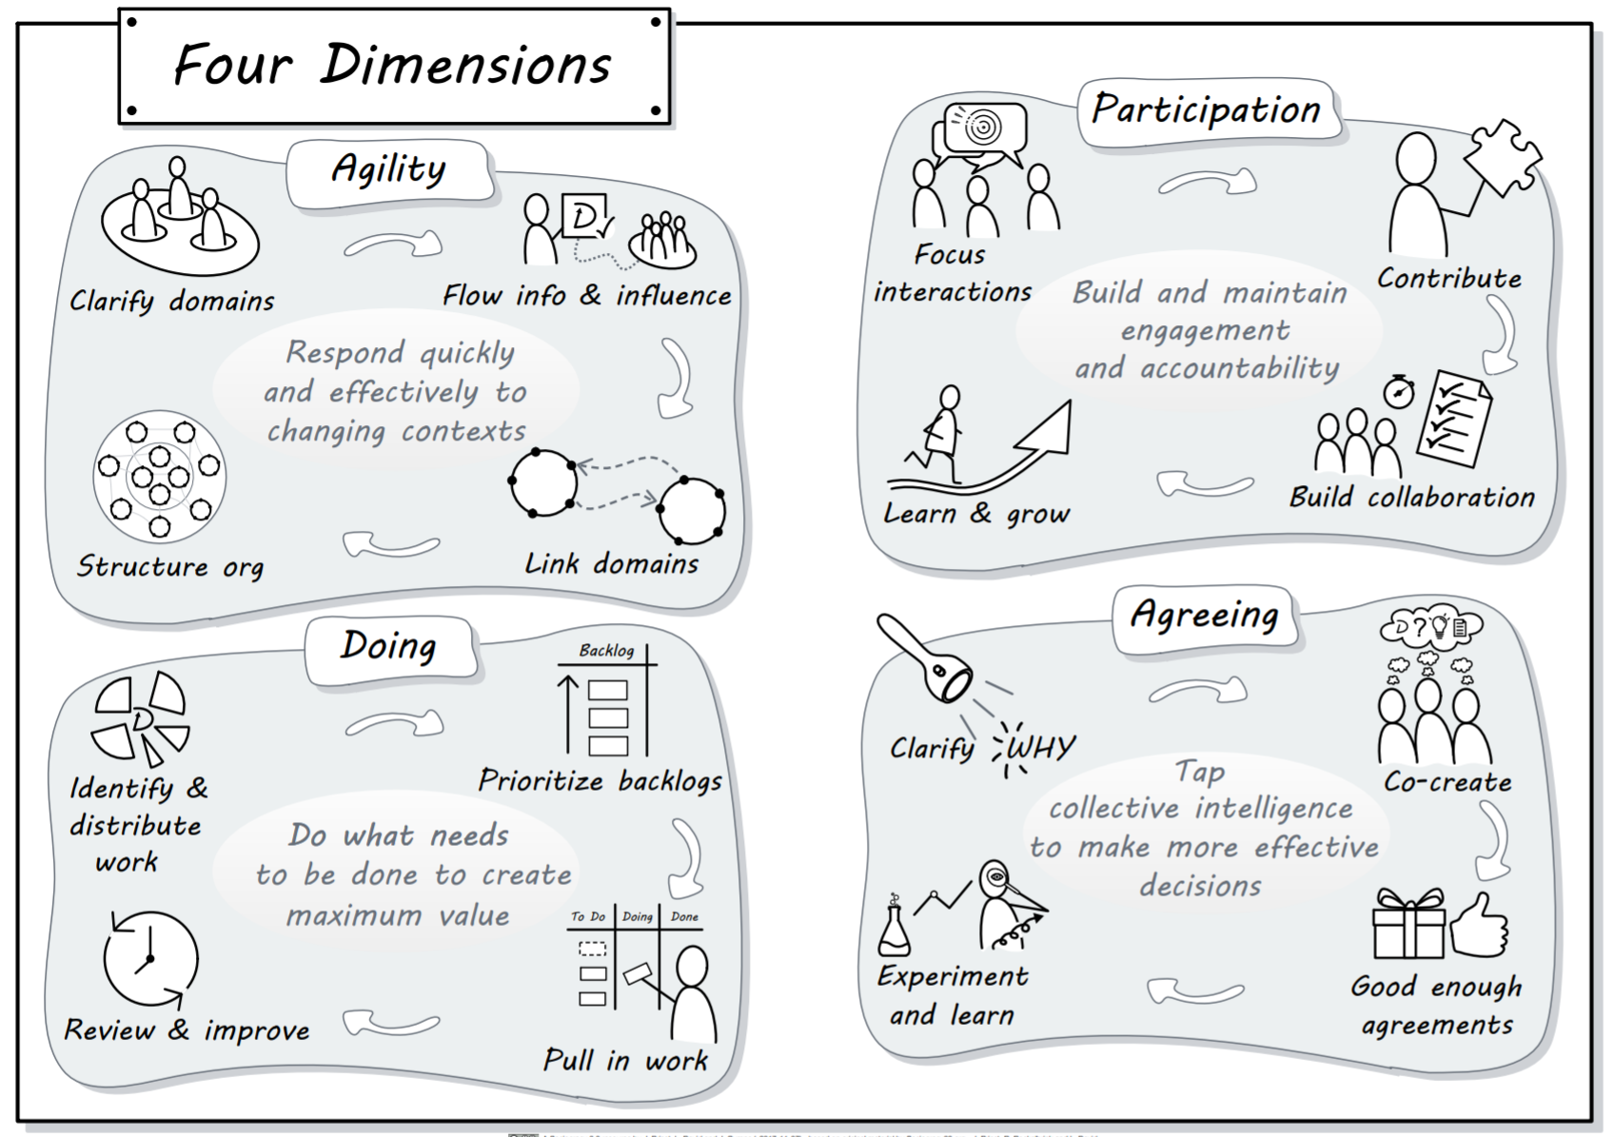
SUMMARY

Slide 18
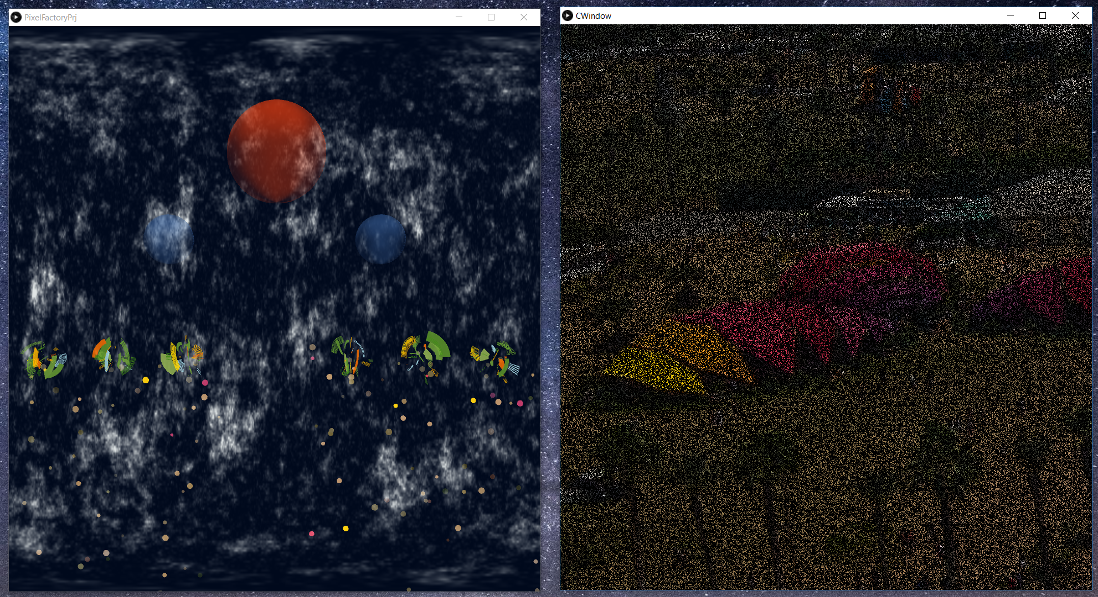
PIXEL FACTORY
Pixel Factory simulates a production environment under two different organizational structures, Hierarchical and Sociocracy based
We try to simulate that power based structures creates inefficiency and kills creativity
The purpose of the simulation work to produce pixels to make a picture visible again which is initially blank
You may imagine “picture” as a customer organization that uses pixels to produce pictures
There is ongoing communications in between Pixel Factory organization and customer
We developed this work to simulate the statement “hierarchy brings inefficiency to the organization”
For Future Tellers 2018 submission we developed a simulation software using Open Source components that supports our statement
We see that under hierarchical world picture is being completed slower, and under sociocracy it is completed faster.
Our simulation creates a base for further development possibilities especially to simulate group learning and community knowledge
In the future we are also planning to add more capabilities to simulate different communications routes and to test some behavioral aspects of the organizations under game like scenarios.
Notes:
“hierarchy brings inefficiency to the organization” statement should be evaluated under a larger context with the guidance of related research in the area, otherwise can be perceived as misguided and inaccurate

Slide 19
PIXEL FACTORY WITH HIERARCHY
Director
Manager
Employee
Employee
Manager
Employee
Employee
Employee
Employee
Pixel Factory with Hieararchy:
Employees ask to big boss/Red Sphere who decides on which color will be produced c1 = pf.ask_to_boss(); ps.setEmitter(x,y,c1);
Employees cannot take actions without asking to big boss
Employees don’t learn from each other, there’s no shared knowledge
Only big boss talks to Customer
Mid Level Managers have no clearly defined tasks and hold their positions mainly of a “power” need
Lower level employees has no power, only has a duty of Pixel production
Due to bottlenecks and slower communications cycles, efficiency is lower
Big boss is always under stress
Notes:
- Big boss is a bottleneck

Slide 20
PIXEL FACTORY WITH HIERARCHY- QUICK DEMO

Slide 21
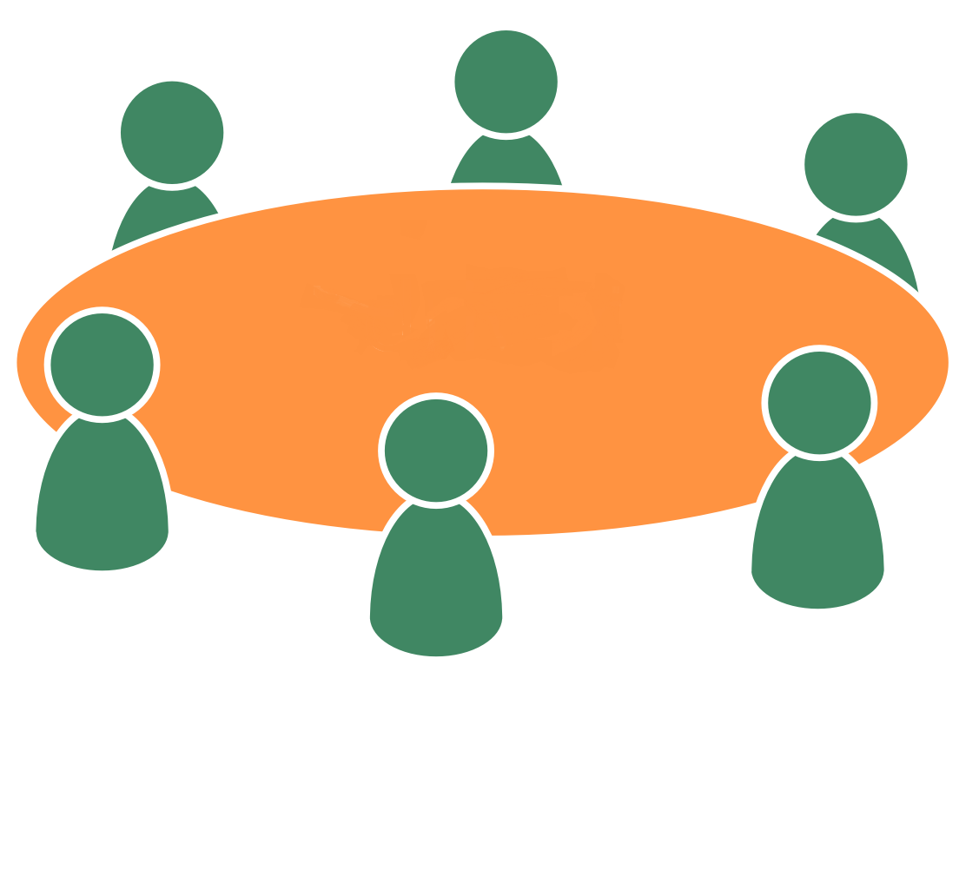
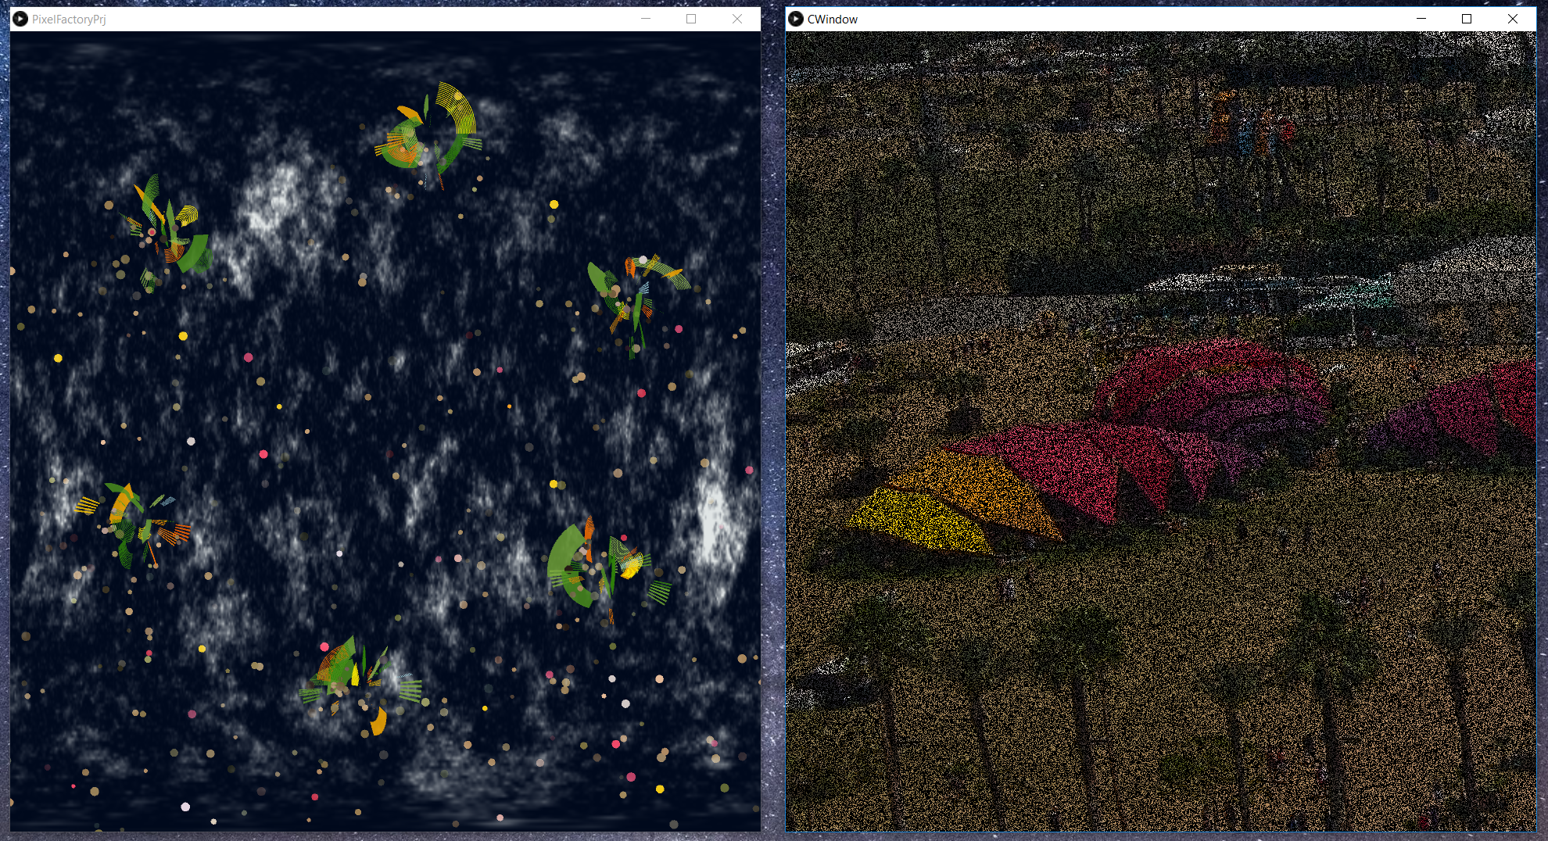
PIXEL FACTORY WITH SOCIOCRACY
Each employee has connection with customer and asks the color that will be produced c1 = fPrjRoot.custPict.tellmeLastColor(); ps.setEmitter(x,y,c1);
Each employee contributes to decisions
Each employee contributes to production
Power and knowledge is shared
There’s no bottleneck that may create unnecessary stress on employees
Not implemented for this phase but they can easily learn from each other

Slide 22
PIXEL FACTORY WITH SOCICRACY - QUICK DEMO
Notes:
Speed cannot be sensed in Powerpoint

Slide 23
BENEFITS OF OPEN SOURCE
Started from scratch in Processing and implemented solution in 3 weeks in parallel of a very heavy schedule
Easy to find samples and references
Possible to reuse existing material even modifying it
Possible to develop and contribute to existing material
Shared knowledgebase for all
Easy to test different tools & methods

Slide 24
REFERENCES
https://sociocracy30.org/
Processing 3 samples: https://processing.org/
http://paulbourke.net/papers/cgat2013/presentation.pdf
http://paulbourke.net/fractals/
http://freemusicarchive.org/music/Graphiqs_Groove/Graphiqs_Groove_2009/09_-_deepskyblue
http://freemusicarchive.org/music/Dream_Metaphor/none_given_1017/cd1_01_dream_metaphor_-_space_traveller
GitHub Link: https://github.com/Barbarosg1/PixelFactory

